Slide 1

24LAI03VIT
Generate DSL Query from Natural Language using Advanced RAG Pipeline

Slide 2
Extracted important parts from PromQL documentation and saved them as a PDF.
Sources:
https://prometheus.io/docs/prometheus/latest/querying/basics/
https://promlabs.com/promql-cheat-sheet/https://betterstack.com/community/guides/monitoring/promql/
Using separate collections for CSV documents (sample PromQL queries dataset) and PDF documents (documentation PDFs).

Slide 3
rag_v7
llama-3.1-8b-instant Milvus Lite (multi-collection) BAAI/bge-m3 Dense Retriever (Similarity-based)
rag_v8
llama-3.3-70b-versatile Milvus Lite (multi-collection) BAAI/bge-m3 Dense Retriever (Similarity-based)
rag_v9 → llama-3.3-70b-versatile | Milvus Lite (multi-collection) + Whoosh BM25 | BAAI/bge-m3 | Hybrid Retriever (Semantic + Keyword-based)

Slide 4
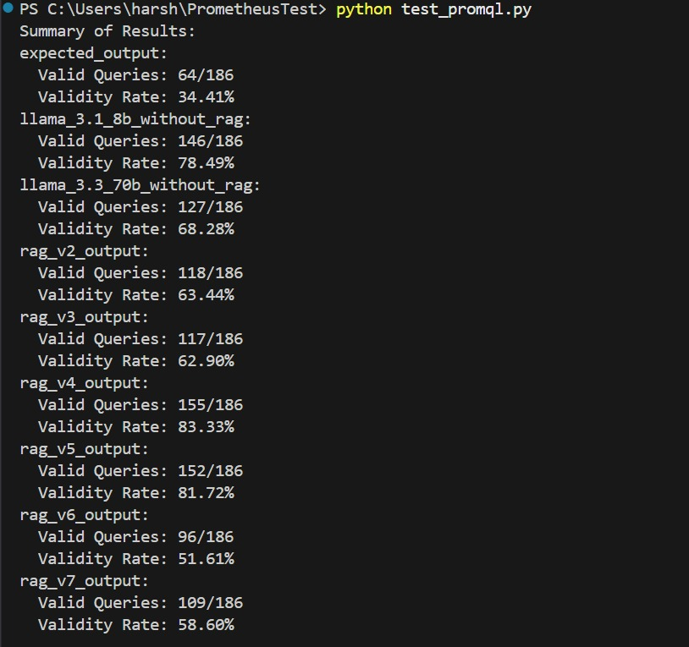
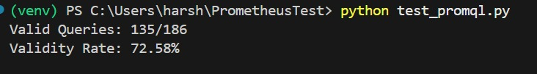
Rag_v8:

Slide 5
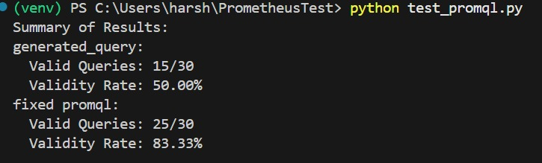
Sample fasle queries generated from rag v8 again passed to the llm to fix the syntax.

Slide 6
Exp_ragv4
K = 5
Chunk Size | Overlap | Accuracy
750 | 150 | 67%
1000 | 200 | 82%
1500 | 200 | 74%
2000 | 200 | 50-60%

Slide 7
OpenTelemetry Integration Report
Created C:\Users\harsh\PrometheusTestWithOpenTelemetry.
Prometheus: Configured on localhost:9090, scrapes localhost:8080.
File: prometheus.yml
OpenTelemetry:
Installed: opentelemetry-api, opentelemetry-sdk, opentelemetry-exporter-prometheus.
Script: otel_app.py generates cpu_usage, memory_usage, checkout_response_time on 8080.

Slide 8
Current Issue
Problem: http://localhost:8080/metrics not accessible.
netstat: No process on 8080.
Invoke-WebRequest: “Unable to connect to the remote server.”
Cause: OpenTelemetry exporter not binding to 8080 despite running

Slide 9
Thankyou !

